Slide 1
R E S EA R C H PR E S E N TAT I ON
Social Media for Travel: An Extended Theory of Planned Behavior Approach
Presented by: Samiksha Gururaj Bondade
and Riya Bhalsod
• Subject: Business Research Methodology
Academic Year 2026

Slide 2
Introduction
Total Literature Search: 50
Total Literature with model 10
Final Topic : Social Media for Travel: An Extended Theory of Planned Behavior Approach

Slide 3
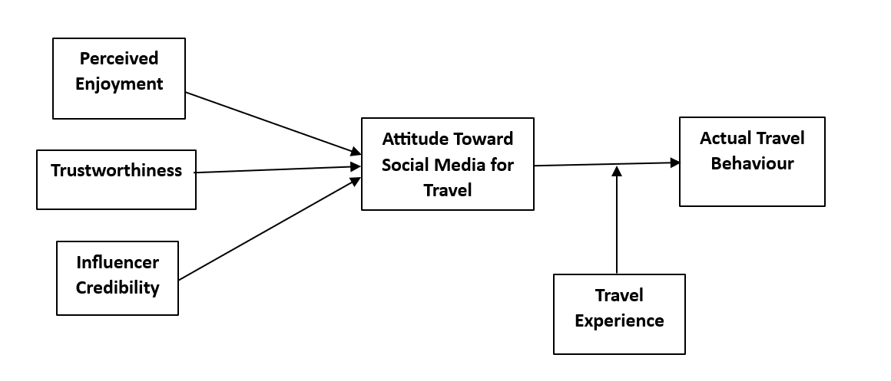
Model

Slide 4
Role of variables
Perceived Enjoyment : Independent
Trustworthiness: Independent
Influencer Credibility: Independent
Attitude Toward Social Media for Travel: Mediator
Travel Experience: Moderator
Actual Travel Behaviour: Dependent

Slide 5
1. Perceived Enjoyment (Independent Variable)
Refers to the level of fun, pleasure, or entertainment a user experiences while using social media for travel.
If users enjoy browsing travel content, they are more likely to develop a positive attitude.
2. Trustworthiness (Independent Variable)
The degree to which users believe that travel information on social media is reliable and honest.
Higher trust leads to stronger confidence in travel-related decisions.
3. Influencer Credibility (Independent Variable)
Refers to how believable, expert, and authentic a social media influencer is.
Credible influencers strongly impact users’ perceptions and travel choices.
4. Attitude Toward Social Media for Travel (Mediator)
Represents the overall positive or negative evaluation of using social media for travel planning.
It acts as a bridge (mediator) between independent variables and actual behavior.
5. Travel Experience (Moderator)
Refers to a person’s past travel knowledge and experience.
It changes the strength of the relationship between attitude and actual travel behavior.
Example: Experienced travelers may rely less on social media.
6. Actual Travel Behaviour (Dependent Variable)
The final outcome—whether a person actually makes travel decisions based on social media.
Includes actions like booking trips, choosing destinations, etc.

Slide 6
Hypothesis
Direct Relationships (Independent → Mediator)
H1: Perceived Enjoyment has a positive effect on Attitude Toward Social Media for Travel.
H2: Trustworthiness has a positive effect on Attitude Toward Social Media for Travel.
H3: Influencer Credibility has a positive effect on Attitude Toward Social Media for Travel.
H4: Attitude Toward Social Media for Travel has a positive effect on Actual Travel Behaviour.
Moderation Effect
H5: Travel Experience moderates the relationship between Attitude Toward Social Media for Travel and Actual Travel Behaviour.
Mediation Hypotheses: H6: Attitude Toward Social Media for Travel mediates the relationship between Perceived Enjoyment and Actual Travel Behaviour.
H7: Attitude Toward Social Media for Travel mediates the relationship between Trustworthiness and Actual Travel Behaviour.
H8: Attitude Toward Social Media for Travel mediates the relationship between Influencer Credibility and Actual Travel Behaviour.

Slide 7
Link of Questionnaire
Link: https://docs.google.com/forms/d/e/1FAIpQLSewhfg6eog0_75qj3YPPZgjCC5geFtPlzSjUQfqzEii3yv3NQ/viewform?usp=dialog
1. Perceived Enjoyment
I find using social media for travel-related content enjoyable. [1], [4]
I have fun exploring travel destinations through social media platforms. [1], [8]
2. Trustworthiness
I consider travel information on social media to be reliable. [2], [10]
I trust the travel-related content shared on social media platforms. [2], [6]
3. Influencer Credibility
I believe that travel influencers provide credible information about destinations. [3], [7]
I trust recommendations given by travel influencers on social media. [3], [9]
4. Attitude Toward Social Media for Travel
I have a positive attitude toward using social media for travel planning. [2], [7]
Using social media for travel decisions is a good idea. [2], [10]
5. Travel Experience
I have significant prior experience in traveling to different places. [4], [8]
My past travel experiences help me make better travel decisions. [4], [5]
6. Actual Travel Behaviour
I often choose travel destinations based on what I see on social media. [1], [6]
Social media influences my actual travel decisions and actions. [2], [9]

Slide 8
Total data collected- 104
List of References
[1] Liu, H., Wu, L., & Li, X. (2018). Social Media Envy: How Experience Sharing on Social Networking Sites Drives Millennials' Aspirational Tourism Consumption. Journal of Travel Research, 1-15.
[2] Ayeh, J. K., Au, N., & Law, R. (2013). Predicting the intention to use consumer-generated media for travel planning. Tourism Management, 35, 132-143.
[3] Leung, X. Y., Zhong, Y. S., & Sun, J. (2025). The impact of social media influencer's age cue on older adults' travel intention: The moderating roles of travel cues and travel constraints. Tourism Management, 106, 104979.
[4] Sedera, D., Lokuge, S., Atapattu, M., & Gretzel, U. (2017). Likes - the key to my happiness: The moderating effect of social influence on travel experience. Information and Management, 54(6), 825-836.
[5] Kathuria, S., Tandon, U., Ertz, M., & Bansal, H. (2020). Social vacation: Proposition of a model to understand tourists' usage of social media for travel planning. Manuscript.

Slide 9
[6] Van Asperen, M., de Rooij, P., & Dijkmans, C. (2017). Engagement-based loyalty: The effects of social media engagement on customer loyalty in the travel industry. International Journal of Hospitality & Tourism Administration.
[7] Singh, S., & Srivastava, P. (2019). Social media for outbound leisure travel: A framework based on technology acceptance model (TAM). Journal of Tourism Futures, 5(1), 43-61.
[8] Kang, M., & Schuett, M. A. (2013). Determinants of sharing travel experiences in social media. Journal of Travel & Tourism Marketing, 30, 1-15.
[9] Christou, E. (2015). Branding Social Media in the Travel Industry. Procedia - Social and Behavioral Sciences, 175, 607-614.
[10] Chung, N., & Koo, C. (2015). The use of social media in travel information search. Telematics and Informatics, 32, 215-229.

Slide 10
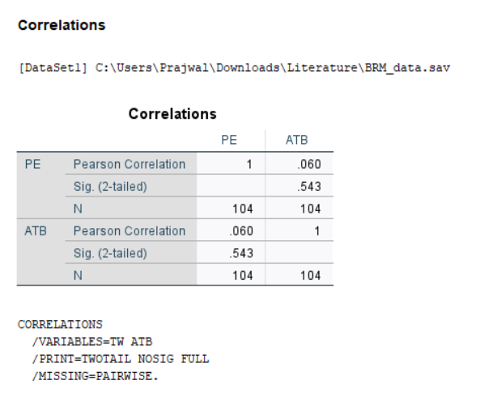
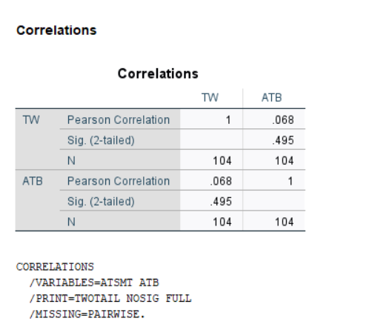
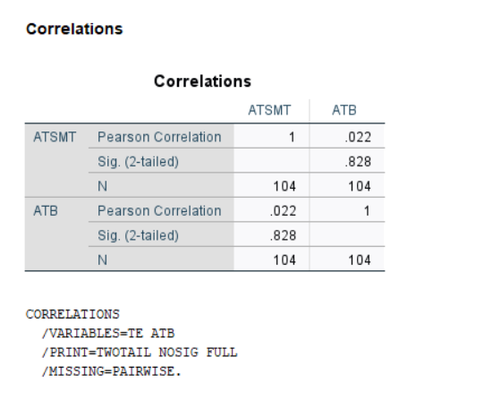
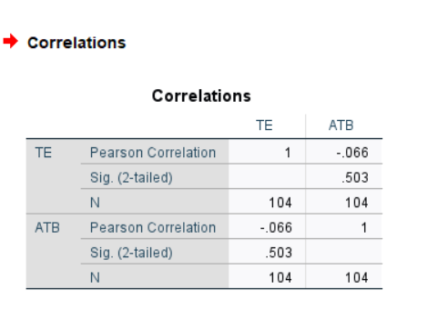
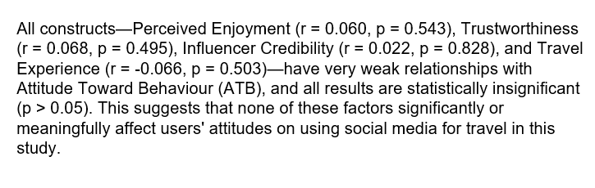
Analysis

Slide 11
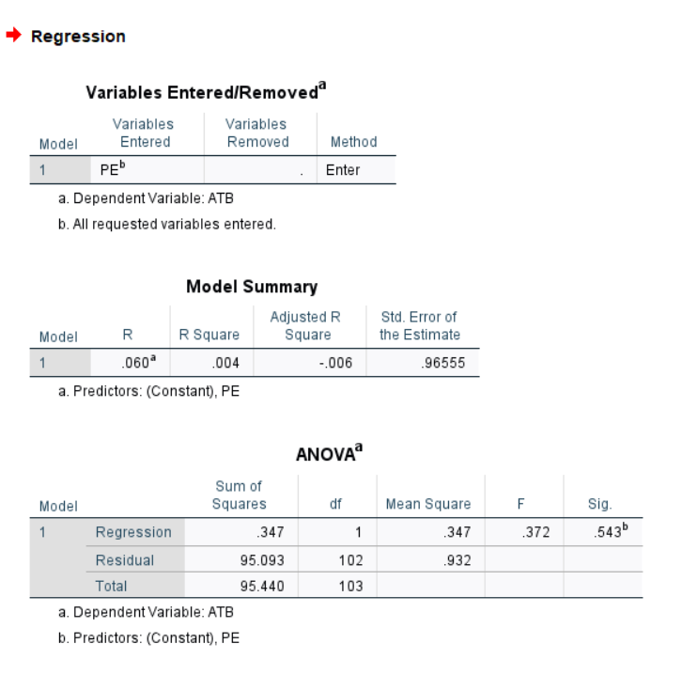
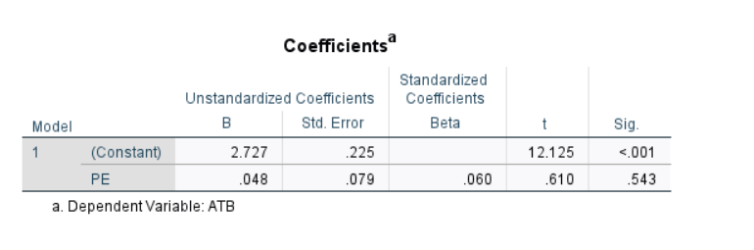
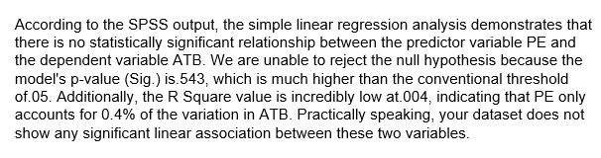

Slide 12
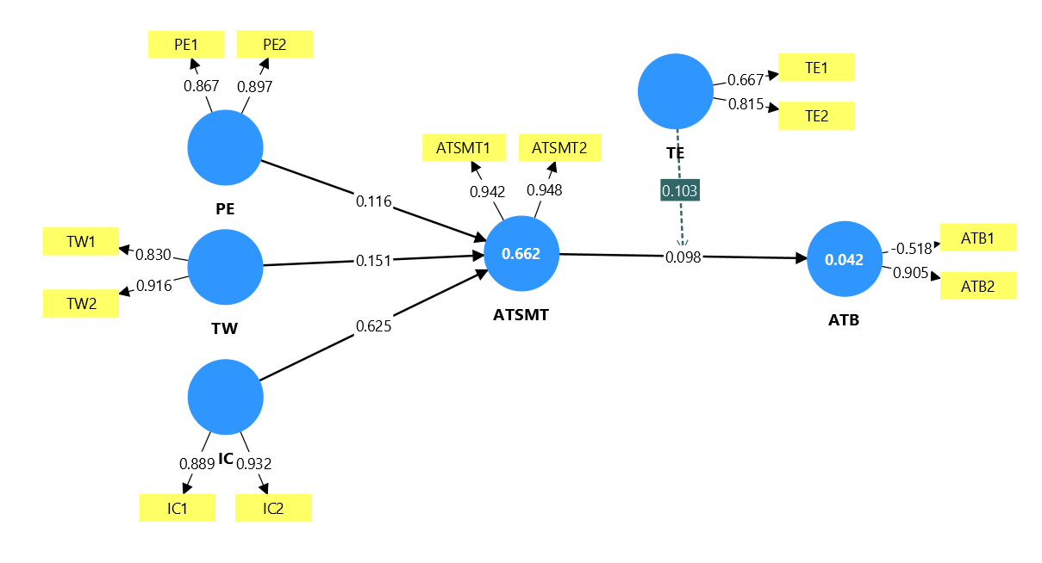
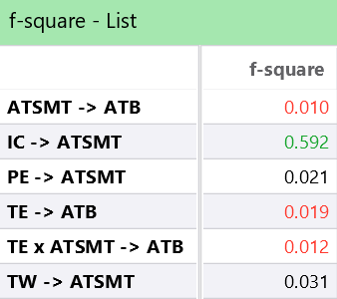
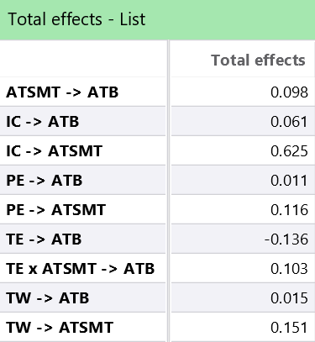
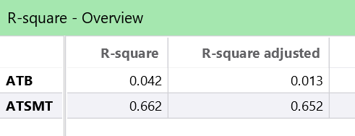
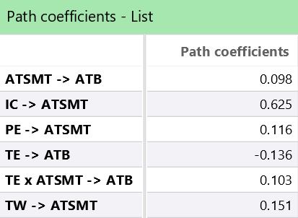
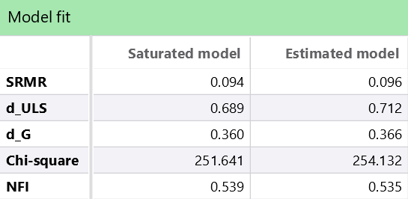
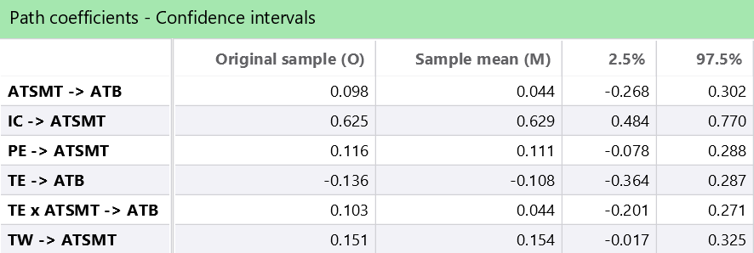
Smart PLS

Slide 13
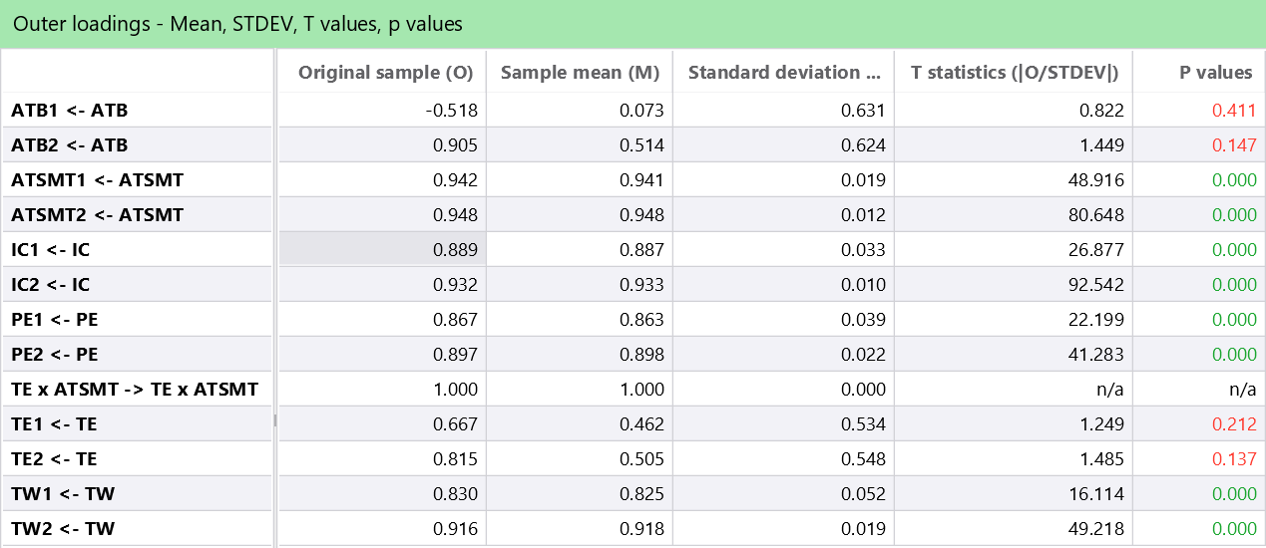
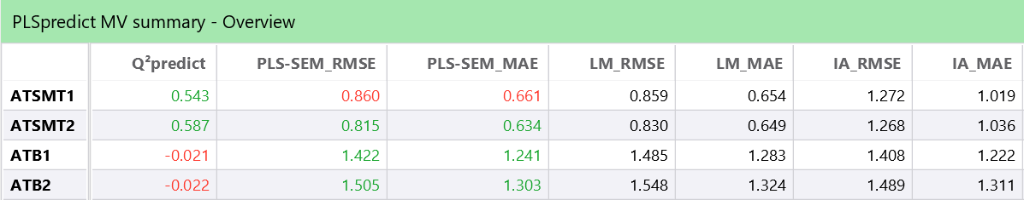

Slide 14

Thank You!
Any Questions or Feedback?
• Year 2026
Business Research Methodology

